Slide 1
Attention Span Analysis
Rishi Gandhi - J022
Vanshika Nijhawan - J047
Suhani Shah - J060
Prsni Kanani - J073

Slide 2
INTRODUCTION
WHAT IS ATTENTION SPAN?
It is the amount of time spent concentrating on a task before getting distracted. Basically concentration power.
It’s not unusual to find your mind wandering when you should be focused on something. According to a 2010 study, we spend nearly 47 percent of our waking hours thinking about something other than what we are doing. And one of the major reasons why our attention span has reduced is the increased using of technology. And so to put this theory to test we decided to analyze a part of it.

Slide 3
We conducted a survey with people from the age group of 13-60 years, and included relevant questions.
We got around 300 responses.
Next, we cleaned the data and edit the entries to form a meaningful dataset.
We used python,excel, and different formulas to make graphs and analyze it.
PROCEDURE

Slide 4
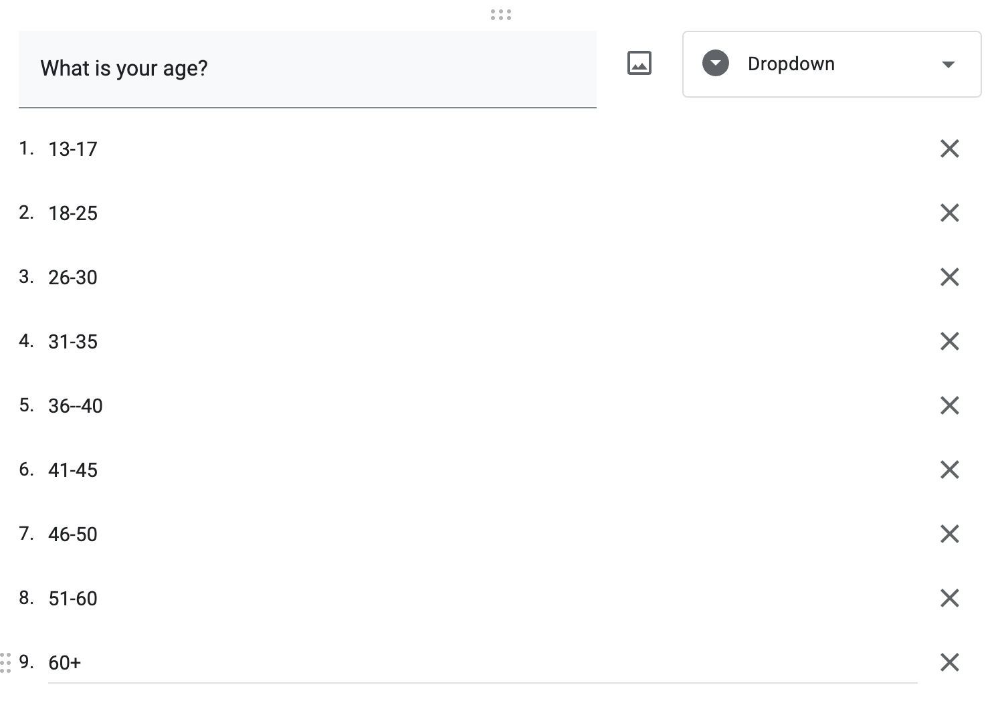
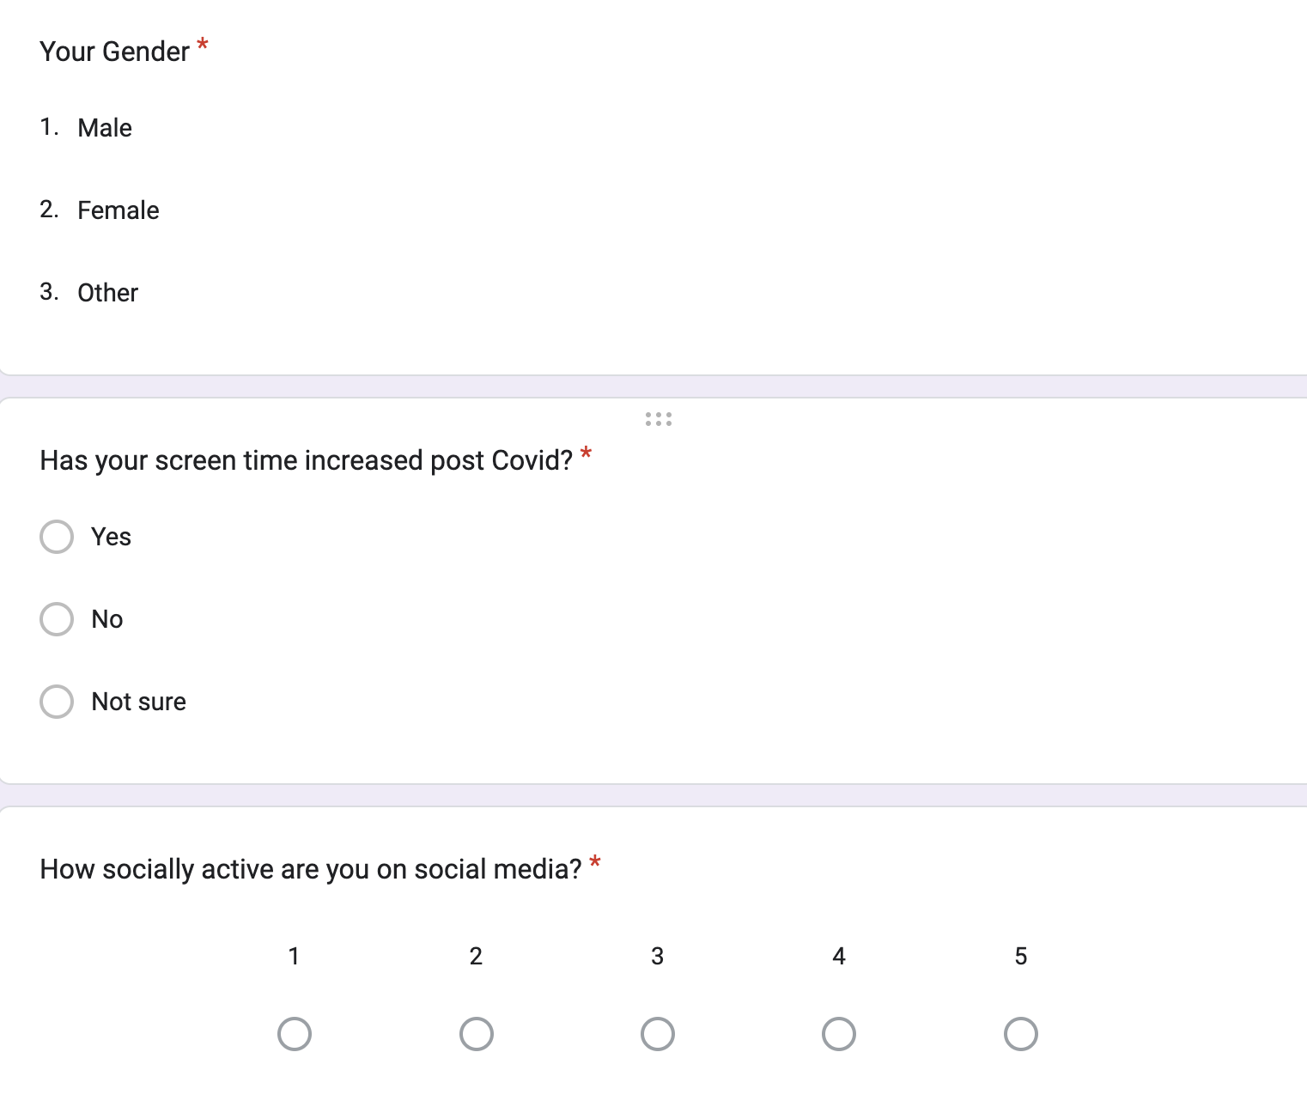
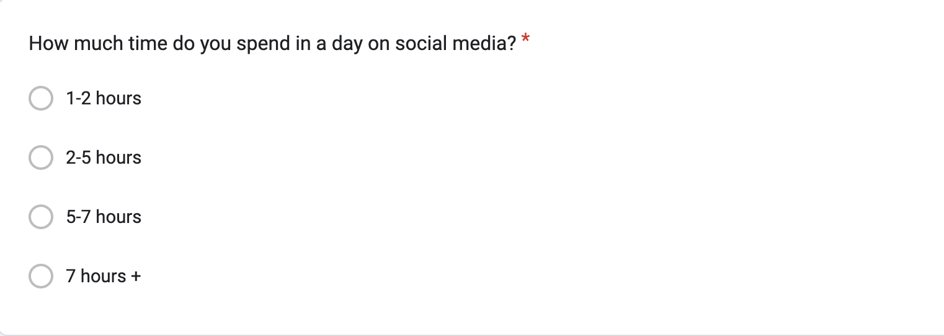
QUESTIONS IN THE GOOGLE FORM

Slide 5
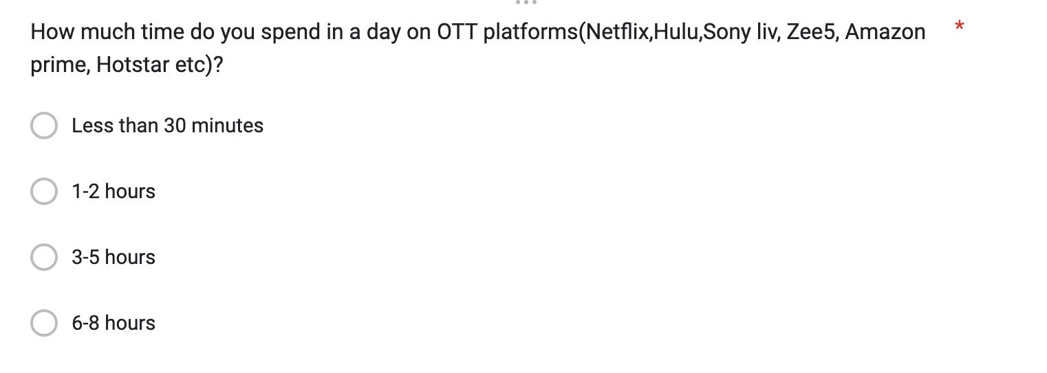
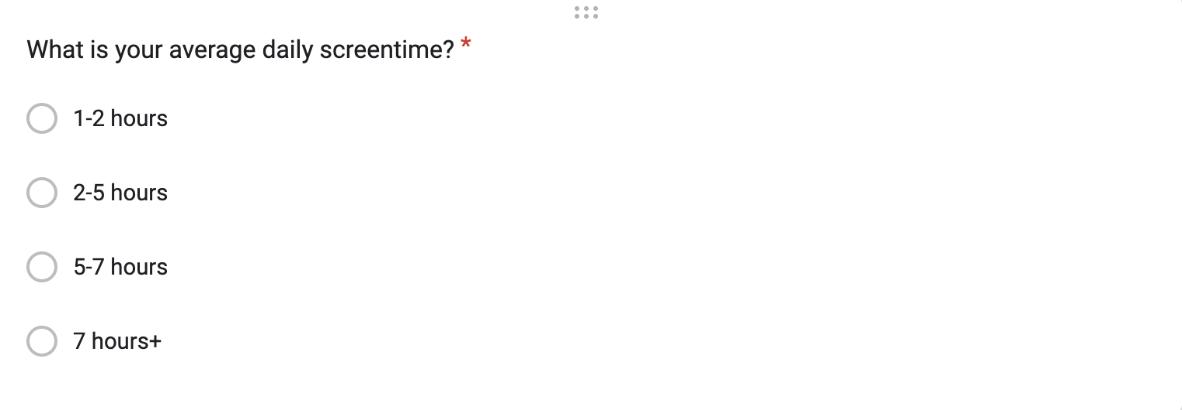
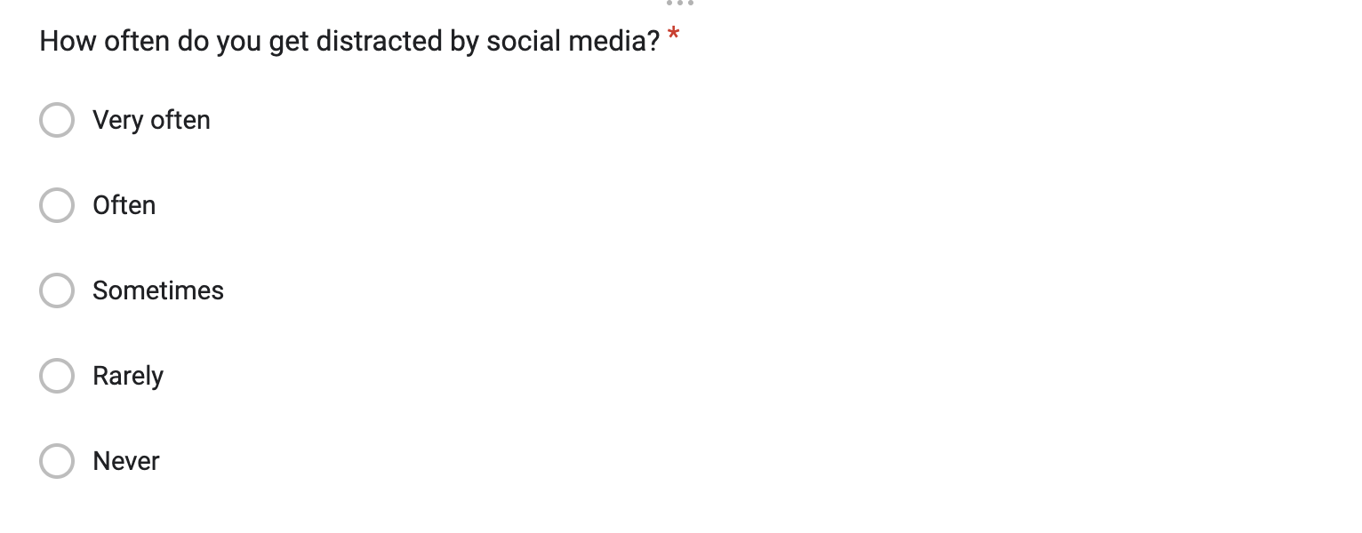
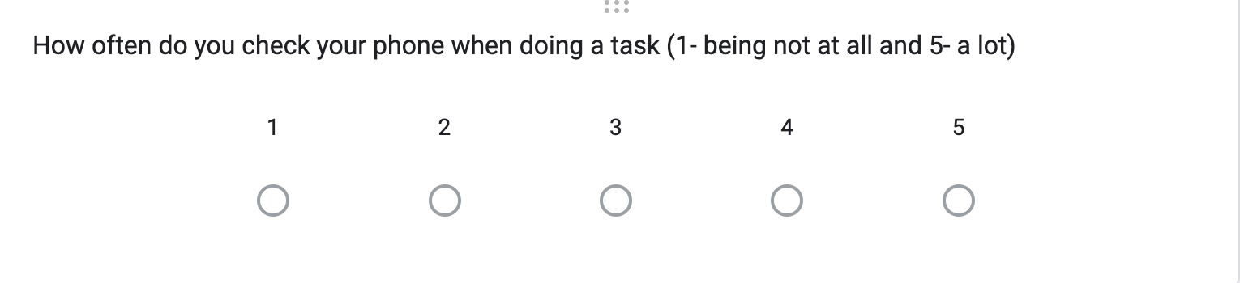
QUESTIONS IN THE GOOGLE FORM

Slide 6
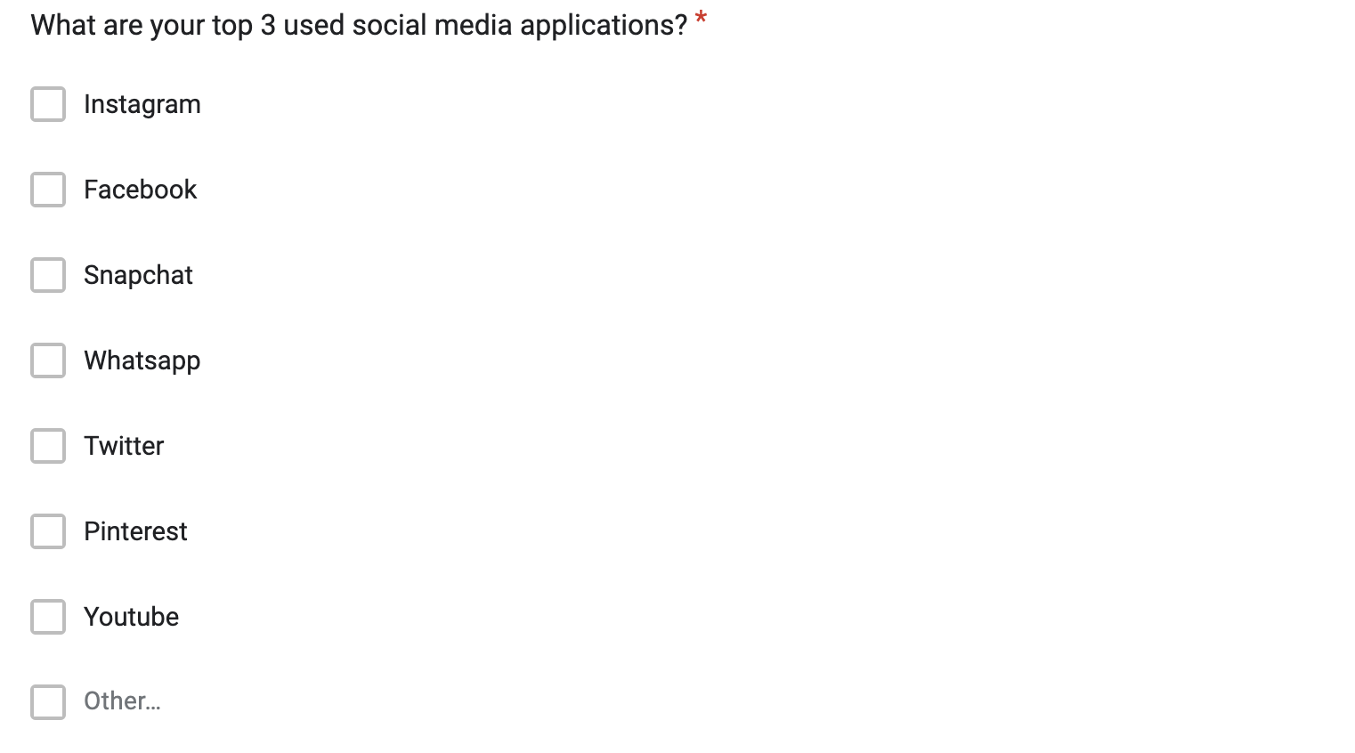
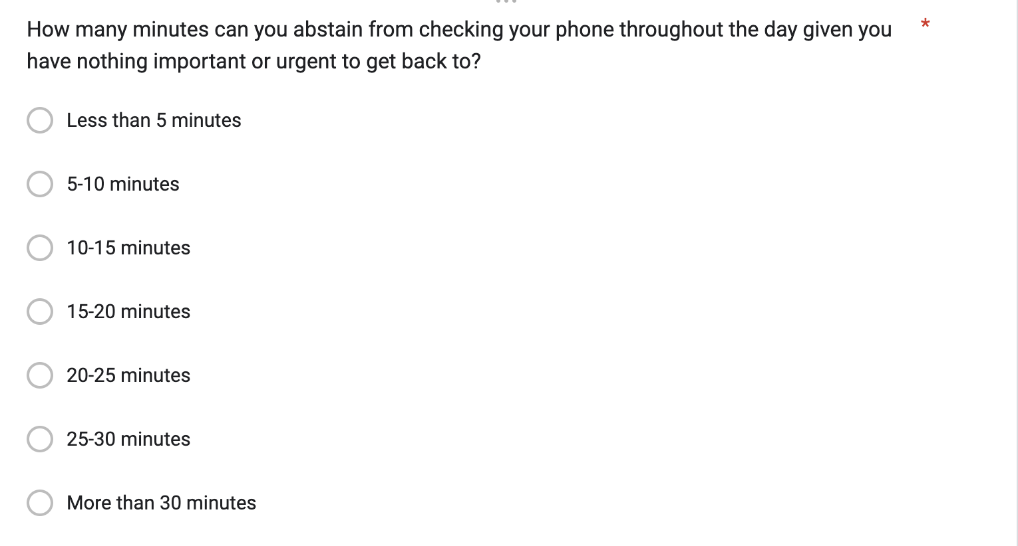
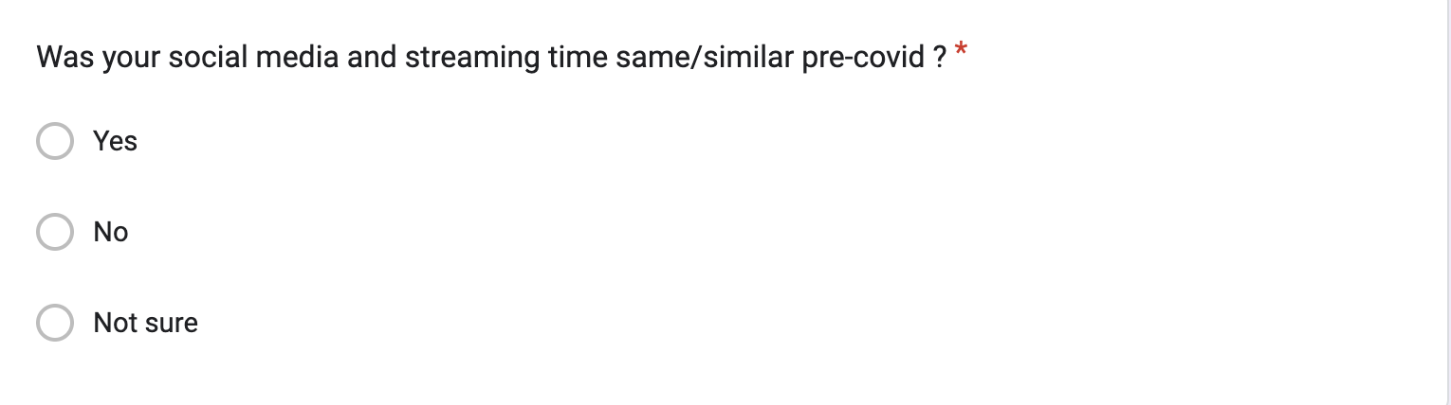
QUESTIONS IN THE GOOGLE FORM

Slide 7
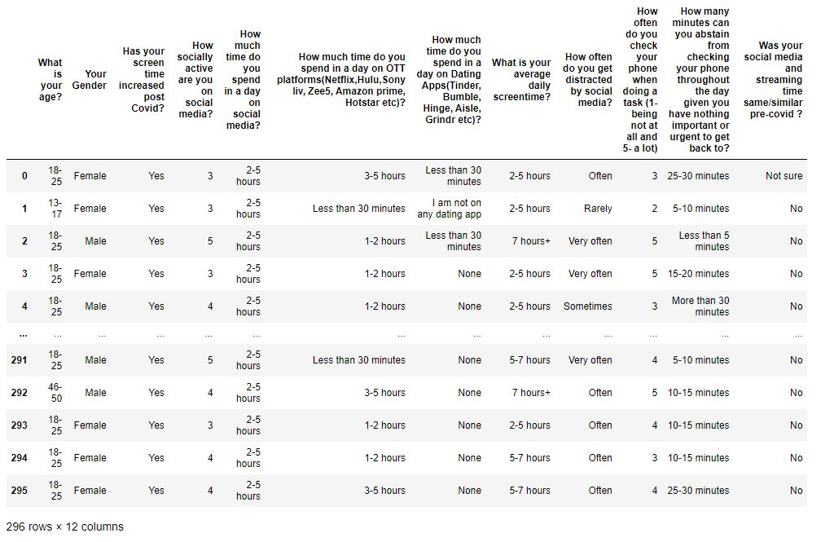
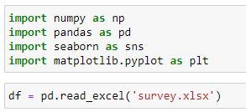
Importing data into Python

Slide 8
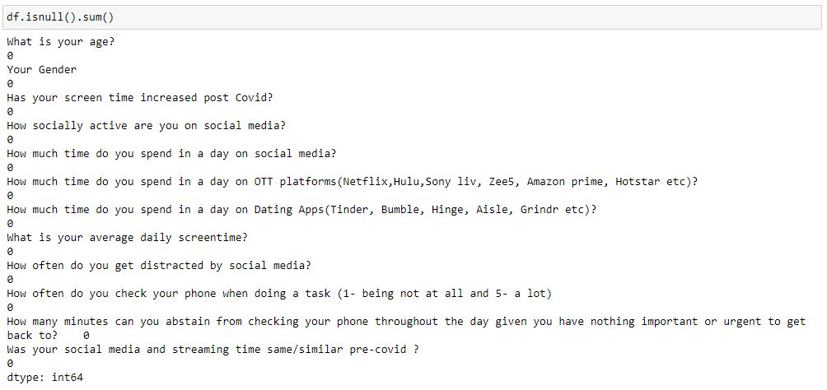
This shows that there are no blank or NA values in our data frame.

Slide 9
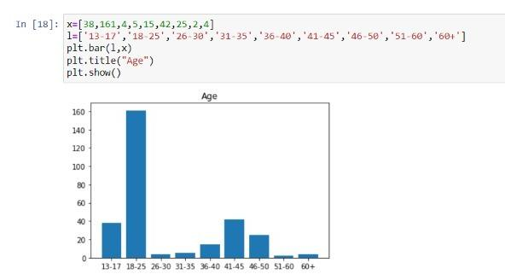
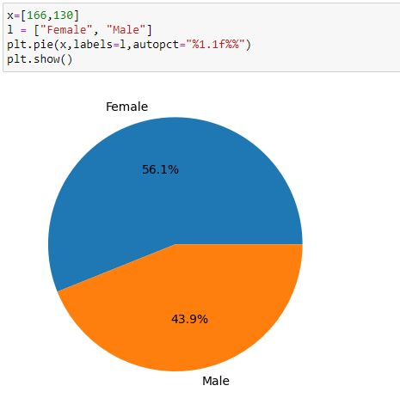

Slide 10
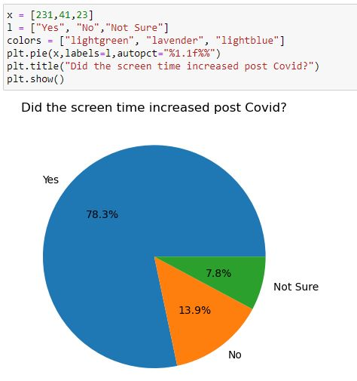
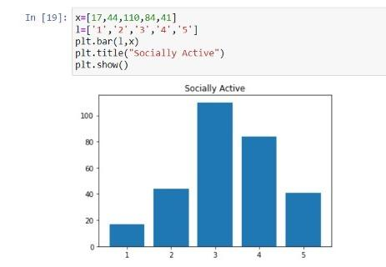

Slide 11
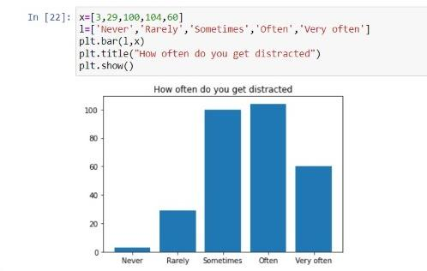
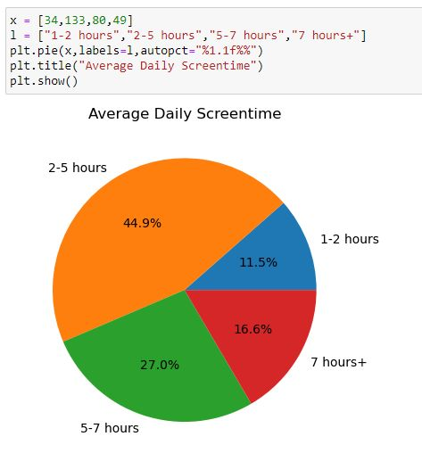
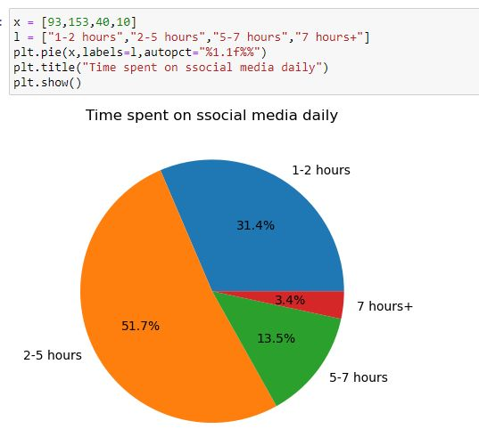

Slide 12
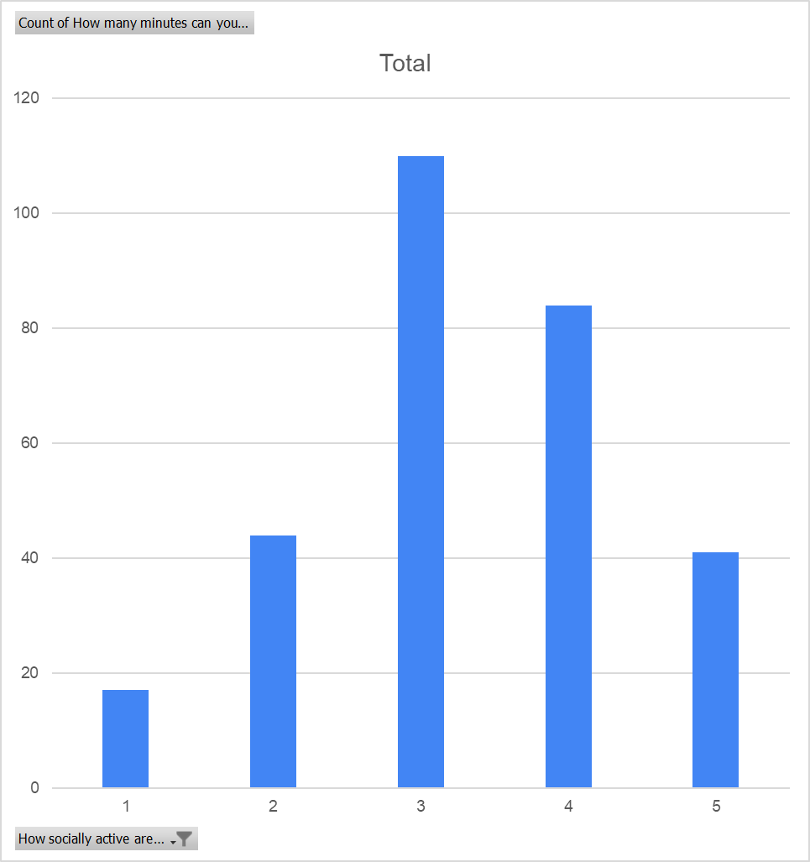
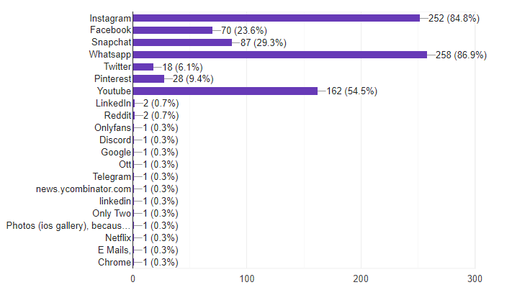
PEOPLE AND THEIR SOCIAL MEDIA CONSUMPTION
MOST USED SOCIAL MEDIA APPS
NO. OF PEOPLE
SOCIAL ACTIVITY ON A SCALE OF 1-5
This graph is slightly negatively skewed, which suggests that there are more number of people who are moderate to very high users of social media.
INSTAGRAM, WHATSAPP, YOUTUBE MOST USED

Slide 13
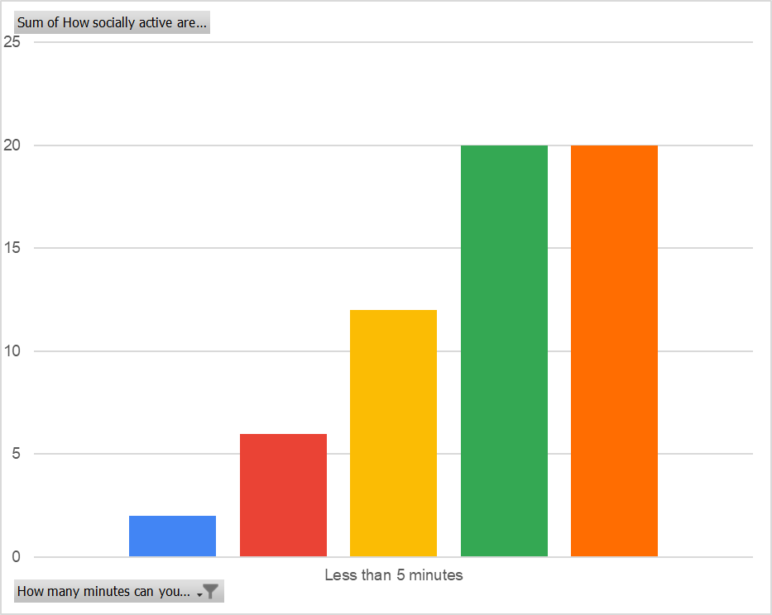
PEOPLE WITH ATTENTION SPAN LESS THAN 5 MINS AND THE SCALE OF ACTIVENESS ON SOCIAL MEDIA
This graph is negatively skewed, which suggests that if you spend more more on social media, you are likely to have less attention span
NO. OF PEOPLE
SCALE OF SOCIAL ACTIVITY (1 TO 5)

Slide 14
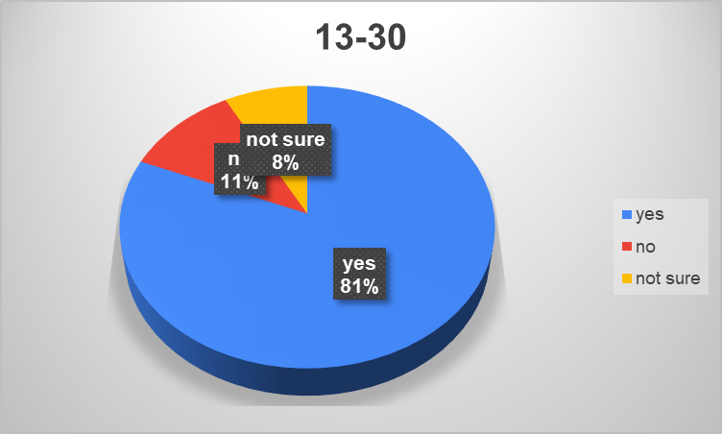
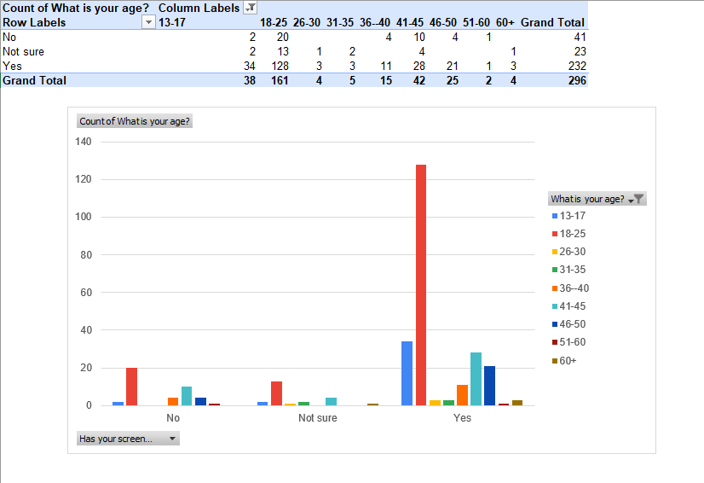
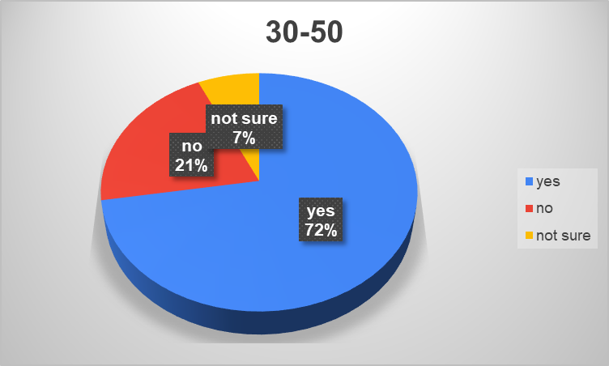
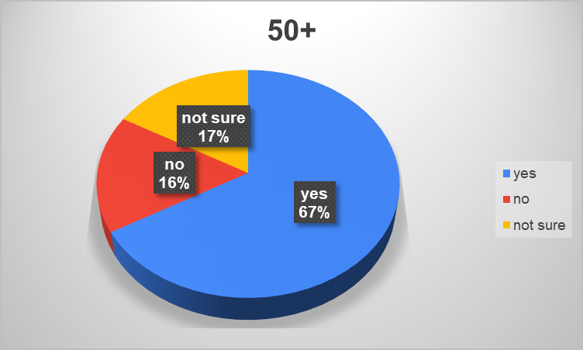
PEOPLE WHO THINK THAT THEIR SCREEN TIME HAS INCREASED POST COVID
IN THE AGE GROUP 13-30 81% OF PEOPLE AGREE THAT THEIR SCREEN TIME HAS INCREASED POST COVID
Its safe to conclude that significant amount of people have faced an increase in the screen time.
IN THE AGE GROUP 31-50, 72% OF PEOPLE AGREE THAT THEIR SCREEN TIME HAS INCREASED POST COVID
IN THE AGE GROUP 50 AND ABOVE, 67% OF PEOPLE AGREE THAT THEIR SCREEN TIME HAS INCREASED POST COVID

Slide 15
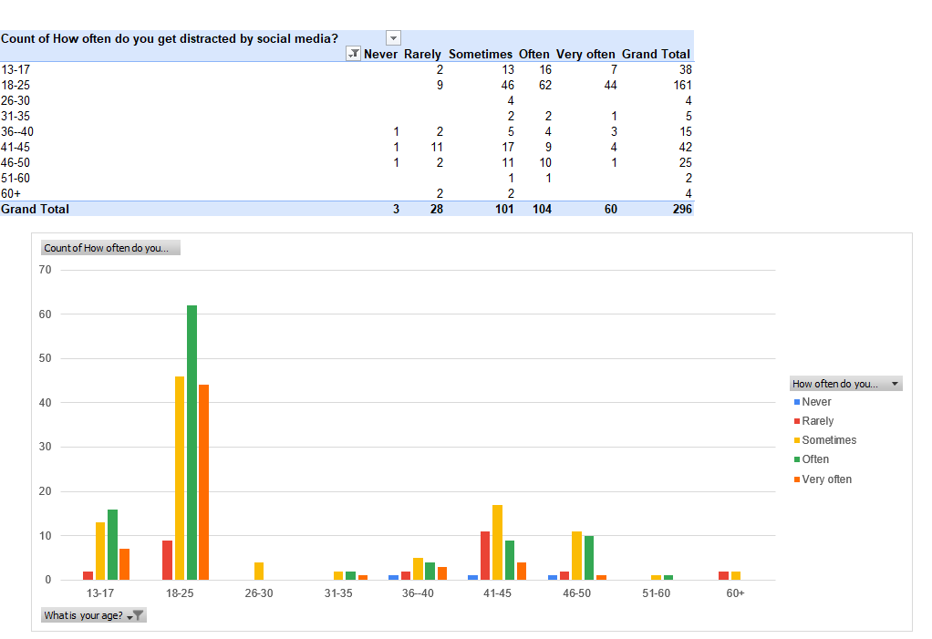
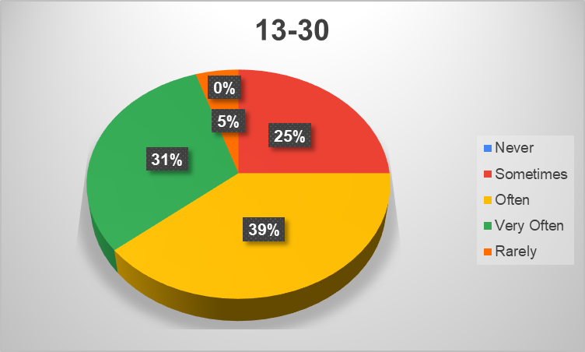
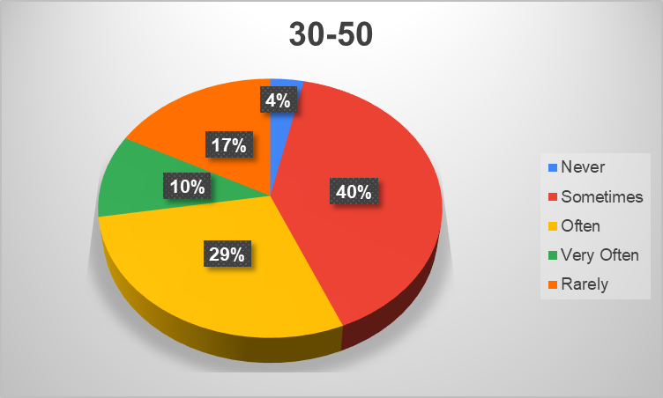
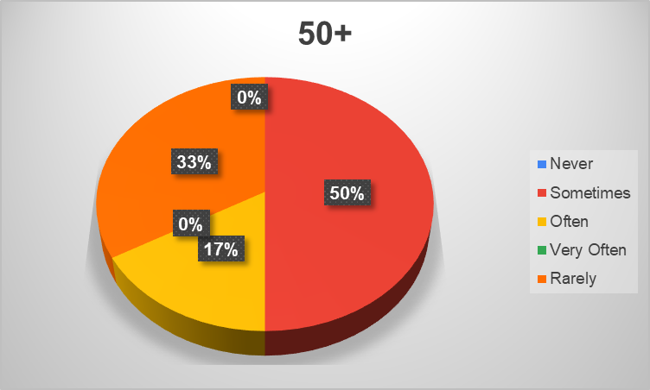
IN THE AGE GROUP 13-30, 70% OF PEOPLE AGREE THAT THEY GET DISTRACTED BY SOCIAL MEDIA. THERE ARE NO PEOPLE WHO AGREE THAT THEY NEVER GET DISTRACTED.
ALL THE PEOPLE WITH THE AGES 50+ AGREE THAT THEY ARE RARELY TO SOMETIMES DISTRACTED BY SOCIAL MEDIA.
IN THE AGE GROUP 30-50, 39% OF THE PEOPLE AGREE THAT THEY ARE DISTRACTED BY SOCIAL MEDIA, AROUND THE SAME NUMBER OF PEOPLE ARE DISTRACTED SOMETIMES AND 21% ARE NOT REALLY DISTRACTED BY SOCIAL MEDIA. THIS IS THE ONLY AGE GROUP THAT AGREES TO NOT BEING DISTRACTED BY SOCIAL MEDIA.

Slide 16
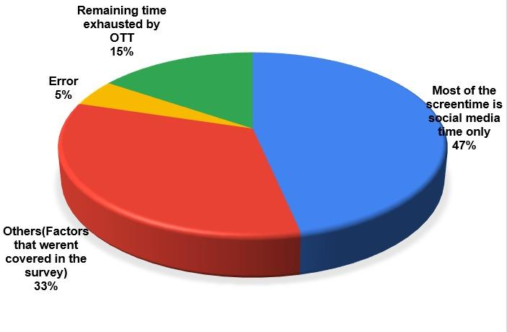
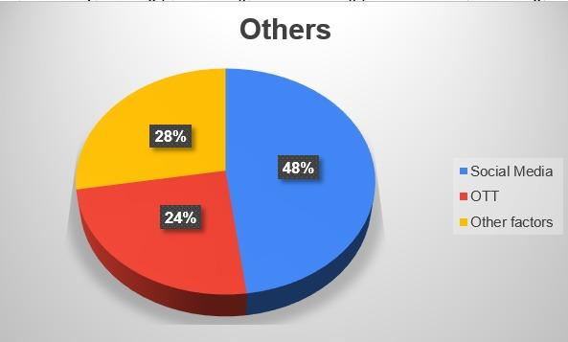
FACTORS AFFECTING THE ATTENTION SPAN - ANALYSIS OF SCREEN TIME
SCREENTIME
SOCIAL MEDIA TIME
DIFFERENCE BETWEEN THE TWO
SCREEN TIME ANALYSIS

Slide 17
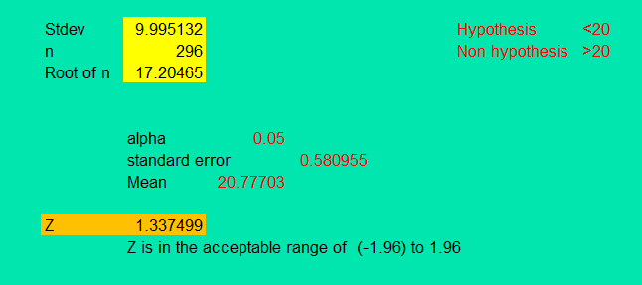
HYPOTHESIS - THE ATTENTION SPAN OF MOST PEOPLE IS LESS THAN 20 MINUTES
(FORMULAS IN EXCEL SHEET)

Slide 18
CONCLUSION
ALL AGES HAVE VERY LESS ATTENTION SPAN
ALL AGE GROUPS USE SOCIAL MEDIA
THE SCREEN TIME POST COVID HAS INCREASED WHICH HAS REDUCED ATTENTION SPAN OF THE PEOPLE
THERE ARE MAJOR DISTRACTIONS CAUSED DUE TO SOCIAL MEDIA USAGE WHICH HAS LEAD TO A REDUCED ATTENTION SPAN
MAJOR PART OF THE SCREEN TIME IS CONSUMED BY SOCIAL MEDIA

Slide 19
THANK YOU!

